Slide 1
Pixelate
Workshop
Computer Vision

Slide 2


Python has no 2d arrays (realistically), so we have NumPy
Numpy is efficient, fast and Pythonic
MatLab like syntax, Python like behaviour
NumPy is suited for Image processing, signal processing, machine learning and a lot of other great stuff

Slide 3
How to Install NumPy
Open cmd with administrator privileges.
Type pip install numpy.

Slide 4
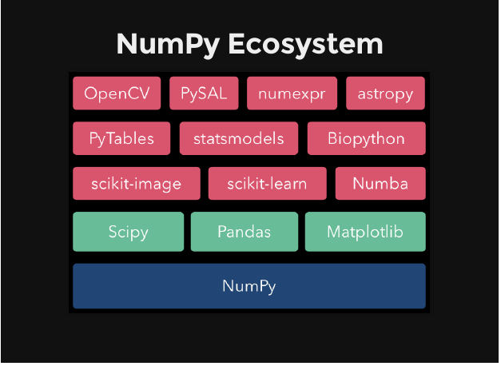

Slide 5
Arrays In NumPy
NumPy’s array class is called ndarray. Also known as alias array.
Main Attributes:
ndarray.ndim : the number of axes (dimensions) of the array.
ndarray.shape : the dimensions of the array.
ndarray.size : the total number of elements of the array. This is equal to the product of the elements of shape.
ndarray.dtype : an object describing the type of the elements in the array

Slide 6
Initializing Arrays
empty() : Return a new array of given shape and type, without initializing entries.
eye(): Return a 2-D array with ones on the diagonal and zeros elsewhere.
identity(): Return the identity array.
ones(): Return a new array of given shape and type, filled with ones.
zeros(): Return a new array of given shape and type, filled with zeros.
full(): Return a new array of given shape and type, filled with fill_value.

Slide 7
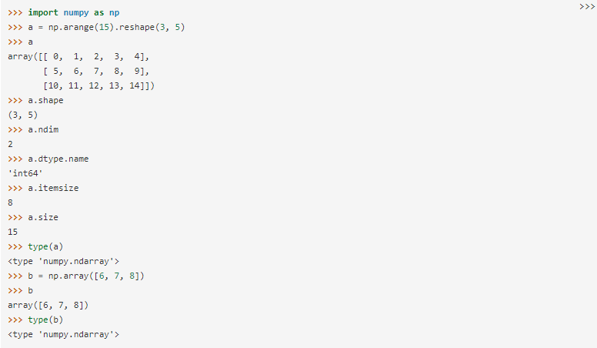
Notes:
Tell how to initialize array in NumPy and basic attributes.

Slide 8
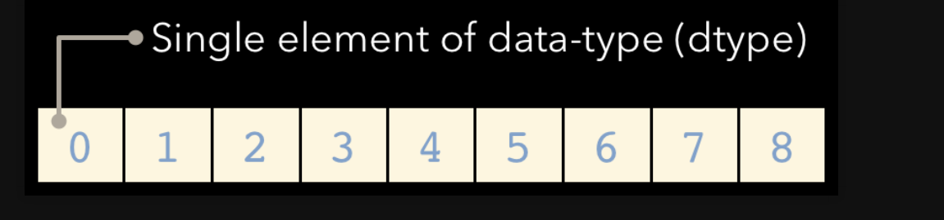
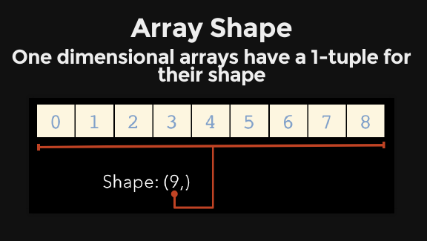
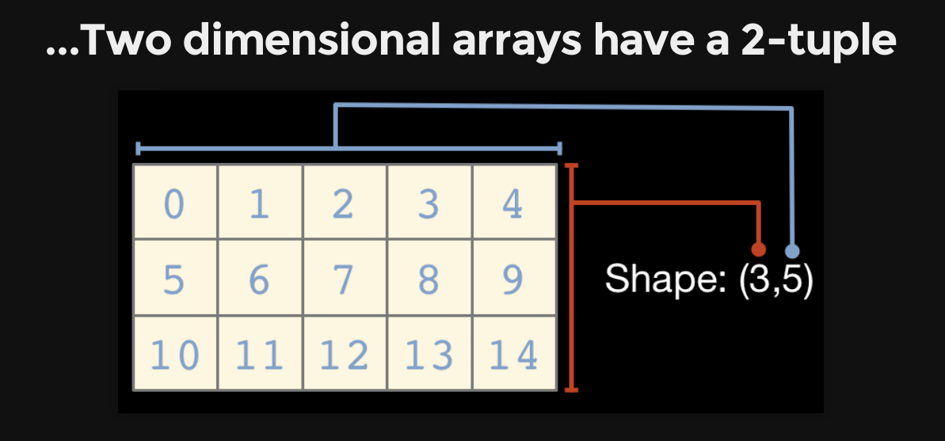

Slide 9
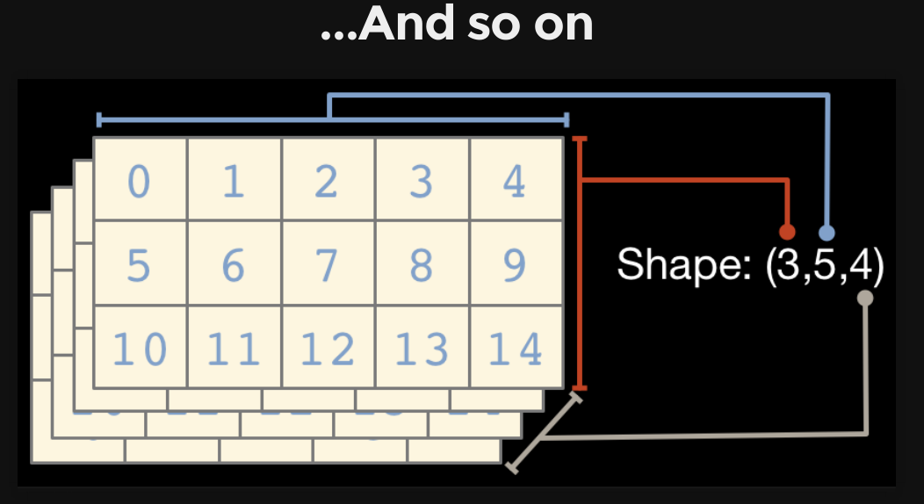

Slide 10
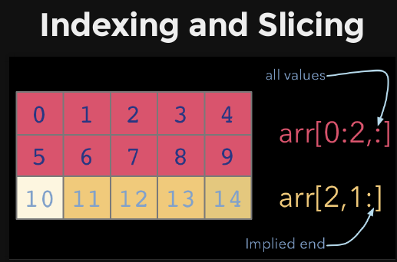
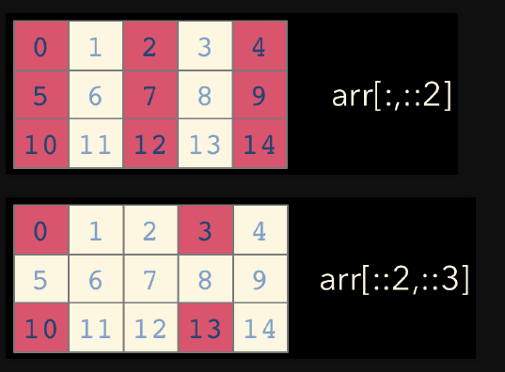
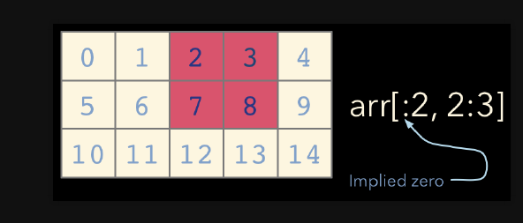

Slide 11
Shape Manipulation
ndarray.ravel
ndarray.T
ndarray.reshape
ndarray.resize

Slide 12
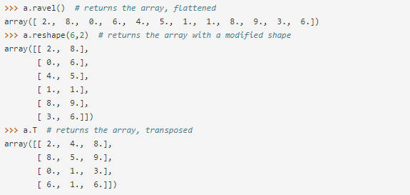
For Example

Slide 13
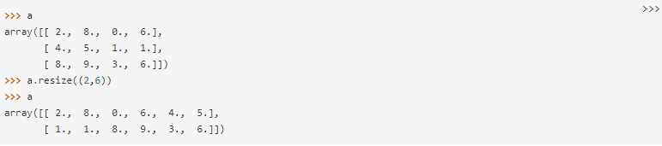
The reshape function returns its argument with a modified shape, whereas the ndarray.resize method modifies the array itself:

Slide 14
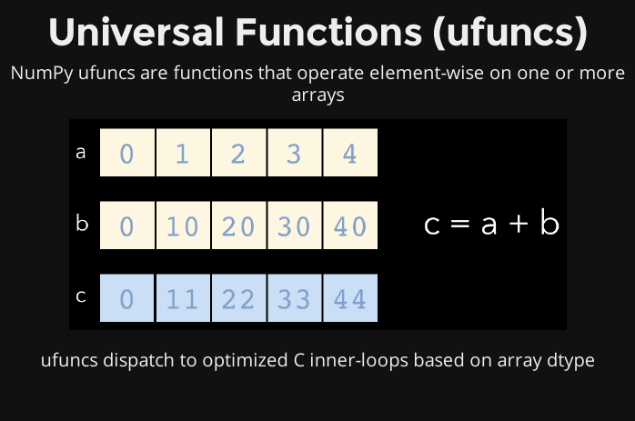

Slide 15
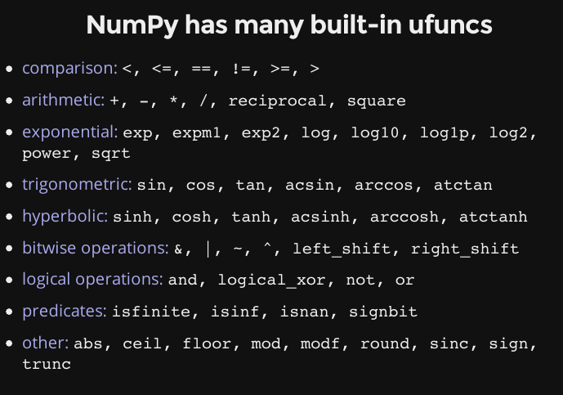

Slide 16
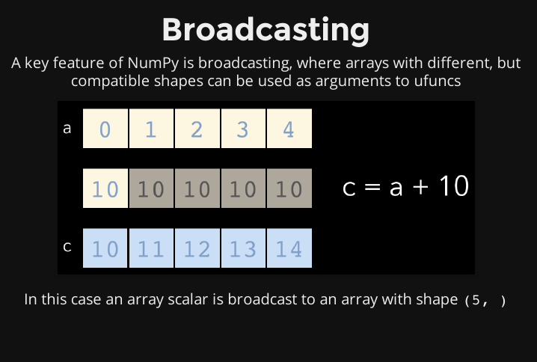

Slide 17
Some Useful Functions
np.sum( ) : Returns the sum of items of array
np.max( ) : Returns the maximum value
np.min( ) : Returns the minimum value
np.argmin( ): Returns the index of minimum value.
np.argmax( ): Returns the index of maximum value.
np.sort( ) : Sorts the array in ascending order.

Slide 18
Some Useful Functions
np.nonzero( ) : Returns the indices of non-zero elements of array.
np.where( ) : Return the indices of elements in an input array where the given condition is satisfied .

